Slide 1
ROC Curves github.com/grauzerj/ROC
Jeff Grauzer
R Users Group – 2/13/2019
github.com/grauzerj/ROC

Slide 2
The Perfect Screening Tool
The perfect screening tool will:
Always correctly identify when a patient has a condition (True Positive – TP)
Always correctly identify when a patient is free of a condition (True Negative – TN)
In other words, the measure will:
Never be positive for a patient without the condition (False Positive – FP)
Never be negative for a patient with the condition (False Negative – FN)

Slide 3
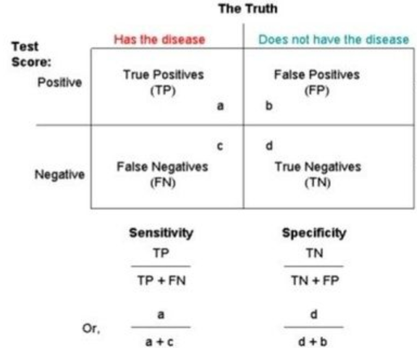
2x2 Contingency Table

Slide 4
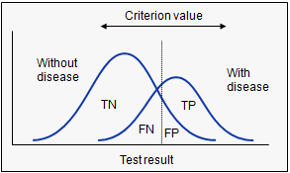
For every possible score cut-off there will be some cases with the condition correctly classified as positive but some cases with the condition will be classified negative.
On the other hand, some cases without the condition will be correctly classified as negative but some cases without the condition will be classified as positive.

Slide 5
ROC Curve Analysis
One way to evaluate the accuracy of a test for all possible score cutoffs is to use Receiver Operating Characteristic (ROC) curve analysis.

Slide 6
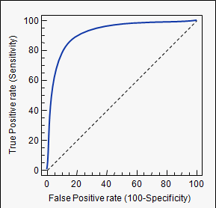
The ROC Curve
In a ROC curve the true positive rate (Sensitivity) is plotted in versus the false positive rate (100-Specificity) for all cut-off points of an assessment.

Slide 7
ROC Analysis in R
How do we compute and plot sensitivity and specificity for all
possible scores of a screener?
How do we find the “optimal” cut-off point for a screener?
How do we assess overall quality of a screener?
How do we compare screening methods against one another?

